Slide 1
Mentors Dr./Mr./Ms.
Project Presentation
RTL Design to Netlist Implementation of Booth Multiplier Using Synopsys Tools
Project Team 1.Thanush Kumar
2.Vivian Halben castelino
3.Melrin Dsouza
4.Amogh Dixit
5.Yashwanth R

Slide 2
Project Team
Sl.No | Registration Number | Name of the Trainee
1 | RSAGWPVLSI26 | Thanush Kumar
2 | RSAGWPVLSI30 | Vivian Halben Castelino
3 | RSAGWPVLSI13 | Melrin Dsouza
4 | RSAGWPVLSI03 | Amogh Dixit
5 | RSAGWPVLSI31 | Yashwanth R

Slide 3
Outline of the Presentation
Introduction​
Title and Aim
Objectives
Solution Methodology
Results and Discussions
References

Slide 4
Introduction
Booth’s multiplication algorithm is a technique that allows the efficient multiplication of binary numbers. It reduces the number of partial products, making it useful in digital signal processing (DSP) and arithmetic logic units (ALUs).
Why Booth Multiplication?
Handles both positive and negative numbers efficiently.
Reduces the number of addition/subtraction operations.
Faster and area-efficient compared to conventional multiplication.

Slide 5
Title and Aim
RTL Design to Netlist Implementation of Booth Multiplier Using Synopsys Tools.
Aim:
The goal of this project is to design, verify, and synthesize a Booth multiplier from RTL (Register Transfer Level) to netlist using industry-standard EDA tools.

Slide 6
Objectives
To design an optimized Booth multiplier using Verilog/VHDL.
To simulate and verify the design using Synopsys VCS.
To check design constraints and static timing analysis using PrimeTime.
To perform formal verification using Formality.
To ensure Design-for-Testability (DFT) compliance using DFT Compiler.
To generate a netlist using Design Compiler.
To analyze power, area, and timing for optimization.

Slide 7
Solution Methodology
Step 1: RTL Design
Implement Booth Multiplier in Verilog/VHDL.
Use Synopsys VCS for functional verification.
Step 2: Linting and Static Checking
Use Spyglass to check for coding errors and design violations.
Step 3: Synthesis
Convert RTL to netlist using Design Compiler.
Optimize for power, area, and timing.
Step 4: Design for Testability (DFT)
Insert scan chains using DFT Compiler.
Ensure testability for manufacturing.

Slide 8
Solution Methodology
Step 5: Static Timing Analysis
Use PrimeTime for setup and hold time verification.
Verify if timing constraints are met.
Step 6: Formal Verification
Compare RTL and netlist using Formality to check equivalence.
Step 7: Final Netlist Generation
Obtain a gate-level netlist for fabrication-ready implementation.

Slide 9
Results and Discussions
Observations:
RTL simulations verified correct functionality.
Static timing analysis confirmed that all paths met timing constraints.
DFT implementation ensured high fault coverage.
Challenges Faced:
Optimizing power while maintaining performance.
Meeting timing constraints in deep submicron technology.

Slide 10
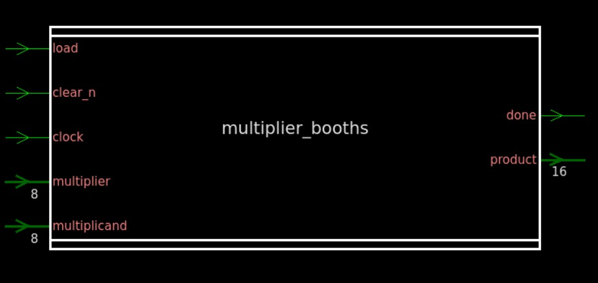
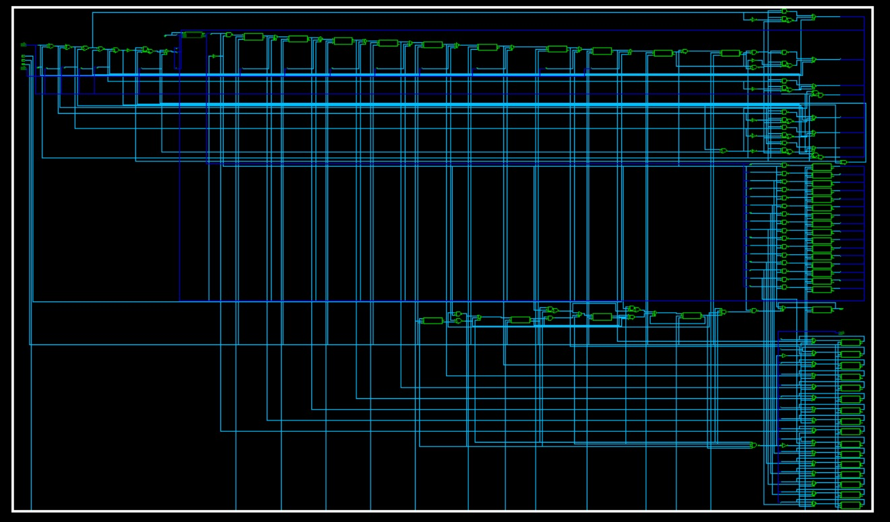
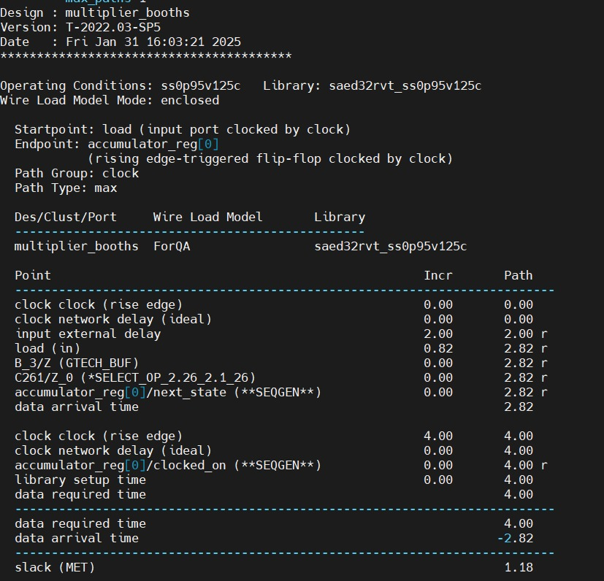
Results

Slide 11
References
Booth, A.D. "A Signed Binary Multiplication Technique," Quarterly Journal of Mechanics and Applied Mathematics, 1951.
Synopsys Tool Manuals (VCS, Design Compiler, PrimeTime, Spyglass, Formality, DFT Compiler).
IEEE Papers on Booth Multiplication Optimization.

Slide 12
Thank You

